Slide 1
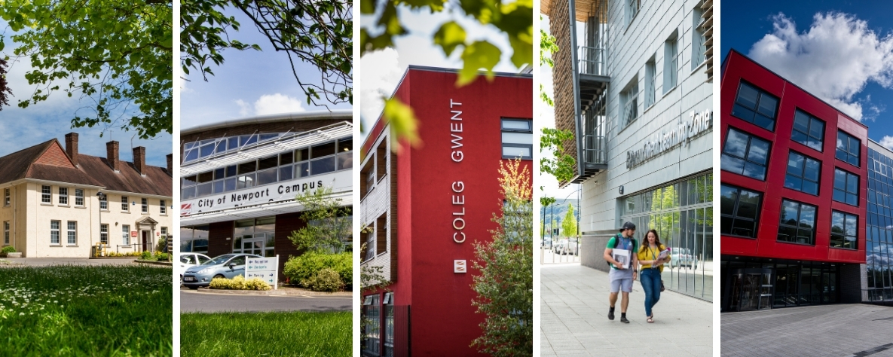
First Diploma ICT Level 2

Slide 2
Index
Introduction
Why the course is for you
What qualifications you will need
What is in the course
Unit One
Unit Two
Unit Three
Unit Ten
Unit Twelve
Unit Thirteen
Unit Seventeen
Unit Nineteen
Unit Twenty-One
Course Teachers

Slide 3
Introduction
In this presentation, you will find information regarding the course, and what you should expect for when you arrive to college and begin taking part.
You will have a great opportunity to gain a broad knowledge and understanding of, and develop skins in the Information Technology sector and even some aspects of the creative industries sector.

Slide 4
Why this course could be for you
You are definitely a match for this course if you:
Want to pursue a career in IT
You want to develop a range of skills and techniques, personal skills and attributes essential for success in your working life.
You have a keen interest in computing and information technology.

Slide 5
What qualifications will you need?
For this course the qualifications you will need are Minimum of 4 GCSEs grade D or above to include either Maths/Numeracy or English/Welsh 1st Language; or an appropriate Level 1 Diploma qualification in the relevant vocational area to include either GCSE Maths/Numeracy or English/Welsh 1st Language grade

Slide 6
What is included in the course?
The Online World (examined)
Technology Systems (examined)
A Digital Portfolio
Creating Digital Animation
Creating Digital Graphics
Database Development
Computer Networks
Software Development
Multimedia Product Development
Computational Thinking
Computing in the Workplace

Slide 7
Unit one – the online world (examined)
This unit will help you understand the main technologies and processes behind the internet and investigate how they come together to let you view websites and send information across the world.
In this unit you will:
A - investigate online services and online communication
B - investigate components of the internet and how digital devices exchange and store information
C - investigate issues with operating online

Slide 8
Unit two – Technology systems (examined)
Technology systems are involved in many of the objects we use every day, from a laptop computer and routers relaying internet traffic, to logging in to a social networking site. This unit provides a first look at how the main building blocks of technology systems work.
Learning Aims
A - understand how the components of technology systems work together
B - understand how data flows between internal components of a computer and is processed to provide information
C - understand different types of software.

Slide 9
Unit three – A digital portfolio
This unit is your chance to show off! A digital portfolio is an exciting onscreen way to showcase your achievements to potential employers or when applying for a course.
It is all about:
The projects you have created and developed
Your use of communication and presentation skills
Your capabilities and potential.
And putting all previous work all together on a website .

Slide 10
Unit ten – database development
Do you use the internet to search for information, such as music tracks, items in an online shop or train times? If so, the chances are that you are using a database without realizing it! Many IT systems involve the use of databases and it is important to understand how they work.
Learning Aims
In this unit you will:
A - Understand the uses of and tools/techniques used in databases
B - Design a relational database
C - Develop and test a relational database
D - Review the finished relational database

Slide 11
Unit twelve – Software development
We live in an age of computer devices, which organisations and individuals have come to rely on. Computer devices are everywhere and advances in these take place daily. It is essential for organisations and IT professionals to develop and maintain software programs that bring to life the technology we all rely on.
In this unit you will:
A - understand the characteristics and uses of a software program
B - design a software program
C - develop and test a software program
D - review the finished software program

Slide 12
Unit thirteen – website development
In this unit, you will investigate the features and uses of websites by exploring what they are and how their integrated components and applications interact with each other.
You will also learn how to design, develop and test a website for a brief. Once this is completed you will review your website, having obtained feedback from others.
Learning Aims
A - Understand the uses and features of websites
B - Design a website
C - Develop and test a website
D - Review the finished website

Slide 13
Unit seventeen – multimedia product development
Multimedia plays an ever expanding and increasingly important role in daily life. It allows you to access information in new and inspiring ways, using combinations of assets such as video, sound effects, music, animation, images and text to create interactive products that are stimulating and easy to use. Relevant job roles include multimedia specialists who use software to manipulate assets into products and software developers/programmers who add functionality by writing computer code.
In this unit you will:
A - Understand the uses and features of multimedia products
B - Design multimedia products
C - Develop and test multimedia products
D - Review the finished multimedia products

Slide 14
Unit nineteen – computing in the workplace
In this unit you will understand the personal characteristics, such as communication and self-management skills, which are valued by employers and you will demonstrate some of these characteristics. You will prepare an application for one job in the IT sector and creative computing industries (e.g. computer games developer or IT technician) demonstrating your technical and employability skills and using your digital portfolio to showcase your achievements. This will also help you decide which skills you should develop further and which career to pursue.
In this unit you will:
A - understand and demonstrate the personal characteristics valued by employers in the workplace
B - prepare an application for an IT/computing job role
C - understand how social media and communication technologies are used in the workplace
D - demonstrate how social media and communication technologies can be used to improve the delivery of a project

Slide 15
Unit twenty-one – a technology business
In this unit you will understand some of the principles of marketing and use these to investigate successful technology-based products and services. To be successful the idea behind the business needs to meet customers' needs, the technology needs to perform as intended and the business needs to function well.
In this unit you will:
LOA - Understand the principles of marketing and investigate successful technology-based product(s) and service(s)
Technology Businesses
Principles of Marketing
LOB - Select and conduct market research on a prototype technology-based product or service
Idea Selection and Review
Primary Field-based Market Research
Secondary Desk-based Market Research
LOC - Produce a basic breakeven analysis for a prototype technology-based product or service
LOD - Produce and present a business plan for a technology-based product or service

Slide 16
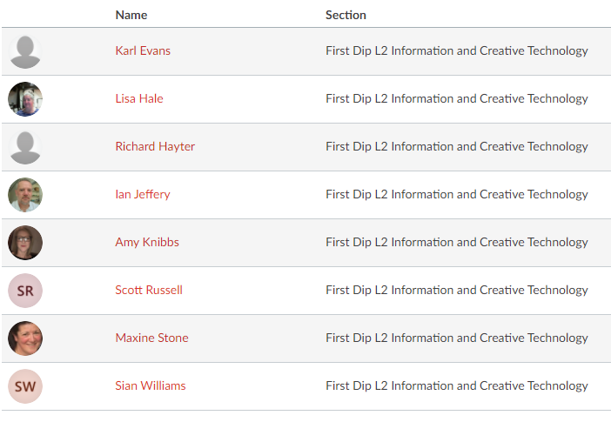
Course teachers

Slide 17
Thank you for choosing IT

